Slide 1
BCD and Gray CODE

Slide 2
Outline
Human Perception
Binary Codes
Decimal and BCD
BCD Operation
Gray Code

Slide 3
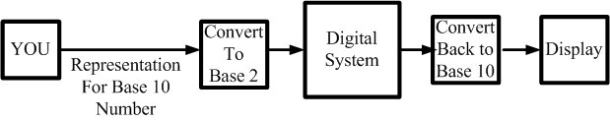
Human perception
We naturally live in a base 10 environment.
Computer exist in a base 2 environment.
So give the computer/digital system the task of doing the conversions for us.

Slide 4
Binary Codes
“An n-bit binary code is a group of n bits that assume up to 2^{n} distinct combinations of 1s and 0s, with each combination representing one element of the set being coded”.
For the 10 digits need a 4 bit code. One code is called Binary Coded Decimal (BCD).

Slide 5
Decimal and BCD
The BCD is simply the 4 bit representation of the decimal digit.
For multiple digit base 10 numbers, each symbol is represented by its BCD digit
Decimal Symbol | BCD Digit
0 | 0000
1 | 0001
2 | 0010
3 | 0011
4 | 0100
5 | 0101
6 | 0110
7 | 0111
8 | 1000
9 | 1001

Slide 6
BCD Operation
Consider the following BCD operation
Decimal: Add 4 + 1
Covert to binary 0 1 0 0
And 0 0 0 1
Getting 0 1 0 1
Which is still a BCD representation of a decimal digit

Slide 7
BCD Operation (cont.)
Another example
3 0 0 1 1
+3 0 0 1 1
Getting 6 or 0 1 1 0
And in range and a BCD digit representation

Slide 8
BCD Operation (cont.)
Another example
Consider 5 + 5
5 0 1 0 1
+5 0 1 0 1
giving 1 0 1 0 which is binary 10 but not a BCD digit!
What to do?
Try adding 6??

Slide 9
BCD Operation (cont.)
Had 1010 and want to add 6 or 0110
So 1 0 1 0
plus 6 0 1 1 0
Giving 1 0 0 0 0
Or a carry out to the next binary digit, or if the binary in BCD, the next BCD digit.

Slide 10
BCD Operation (cont.)
Another carry example
Add 7 + 6
have 7 0 1 1 1
plus 6 0 1 1 0
Giving 1 1 0 1 and again out of range
Adding 6 0 1 1 0
Giving 1 0 0 1 1 so a 1 carries out to the next BCD digit
FINAL BCD answer 0001 0011 or 13₁₀

Slide 11
BCD Operation (cont.)
Multi Bit BCD
Add the BCD for 417 to 195 (Would expect to get 612)
BCD setup - start with Least Significant Digit
417 0 1 0 0 0 0 0 1 0 1 1 1
195 0 0 0 1 1 0 0 1 0 1 0 1
1 1 0 0
Adding 6 0 1 1 0
Gives 1 0 0 1 0

Slide 12
BCD Operation (cont.)
Multi Bit BCD
Had a carry to the 2nd BCD digit position
1
0 1 0 0 0 0 0 1 done
0 0 0 1 1 0 0 1 0 0 1 0
1 0 1 1
Again must add 6 0 1 1 0
Giving 1 0 0 0 1 And another carry

Slide 13
BCD Operation (cont.)
Multi Bit BCD
Had a carry to the 3rd BCD digit position
1
0 1 0 0 done done
0 0 0 1 0 0 0 1 0 0 1 0
0 1 1 0
And answer is 0110 0001 0010 or the BCD for the base 10 number 612

Slide 14
Gray Code
When we count up or down in binary, the number of bit that change with each digit change varies.
From 0 to 1 just have a single but
From 1 to 2 have 2 bits, a 1 to 0 transition and a 0 to 1 transition
From 7 to 8 have 3 bits changing back to 0 and 1 bit changing to a 1
For some applications multiple bit changes cause significant problems.

Slide 15
Gray Code
Contrast of bit changes
Value | Binary | Number of bit change | Gray | Number of bit change
0 | 000 | --- | 000 | ---
1 | 001 | 1 | 001 | 1
2 | 010 | 2 | 011 | 1
3 | 011 | 1 | 010 | 1
4 | 100 | 3 | 110 | 1
5 | 101 | 1 | 111 | 1
6 | 110 | 2 | 101 | 1
7 | 111 | 1 | 100 | 1
0 | 000 | 3 | 000 | 1

Slide 16
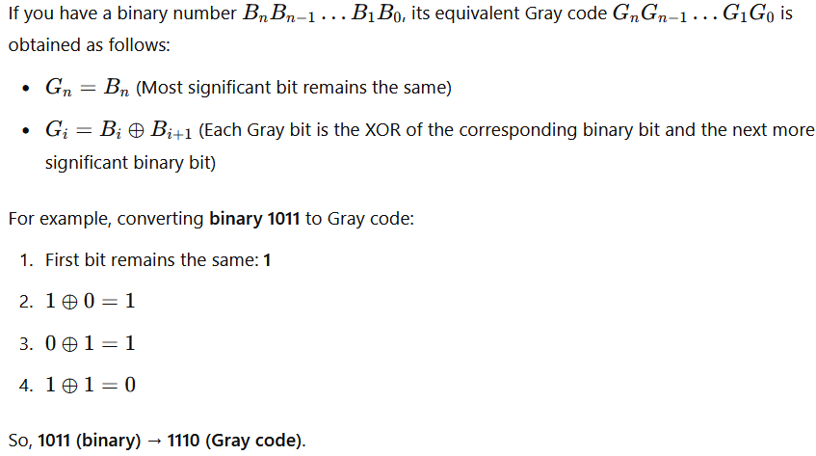
Binary to Gray Code Conversion Rule

Slide 17
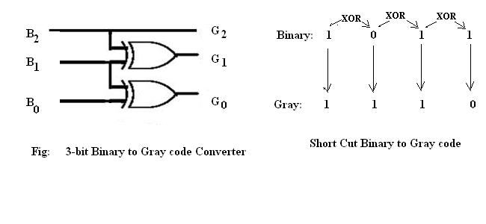
Binary to Gray Code Converter
Logic Design

Slide 18
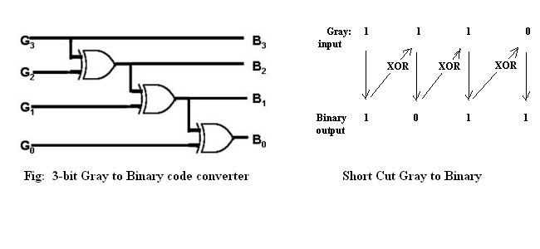
Gray to Binary Code Converter
Logic Design
4

